Slide 1
Credit Card Fraud Detection System
- SAYDAIN SHEIKH

Slide 2
AGENDA
Objective
Background
Key Insights from EDA
Cost Benefit Analysis
Appendix:
Data Attributes
Data Methodology

Slide 3
Objective
The main goal is to build a Credit Card Fraud Detection that can prevent costs incurred due to Fraudulent transactions done through credit card skimming and through online phishing attacks
Banks are going through losses because they don’t have the machine learning models to detect the fraud cases and instead have manual detection system that hardly checks the fraudulent transactions

Slide 4
Background
A Machine learning model has been built on a training data set to prevent fraud cases from occurring and it predicts the fraud cases on unseen data
A Cost Benefit Analysis has been done to understand the business impact of the deployed ML model to take important business decisions

Slide 5
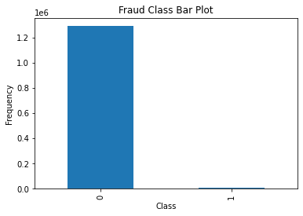
Key Insights From EDA
As we can infer from the given Bar Plot, there is a great discrepancy between Fraud and non-Fraud cases and thereby it will hard to detect fraud cases from a data set that large as it is few in number that could cause loss to the bank

Slide 6
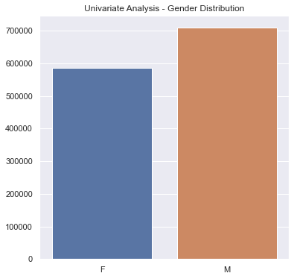
Key Insights From EDA
Looking at the Univariate Analysis, There are more Male customers ( Around 700,000) than Female Customers (Around 580000)

Slide 7
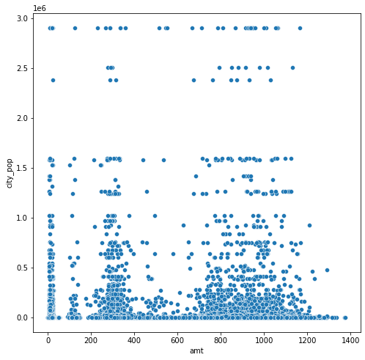
Key Insights From EDA
The given Graph is the scatter plot between Amount and City Population, but there is no clear established relationship between these features

Slide 8
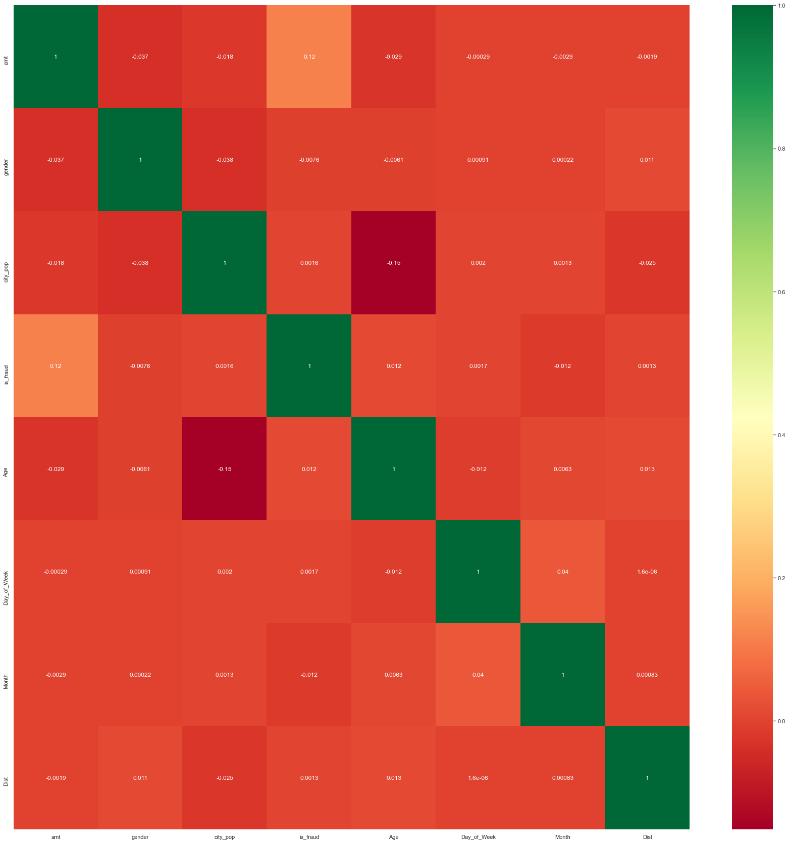
Key Insights from EDA
The is a Correlation Heat Map for the given data set, where the features ‘Amount’ and ‘is_fraud’ have a correlation value of 0.12 and thereby they have a relation that could explain us where the fraud cases are occuring

Slide 9
Cost Benefit Analysis (Values before Model Deployment)
Average Number of Transactions per month are: 77183
Average Number of fraudulent transactions per month are: 402
Average Amount per fraudulent transaction is : 121.0

Slide 10
Cost Benefit Analysis (Values After Model Deployment)
Total cost of providing customer support per month for fraudulent transactions detected by the model = 459
Cost incurred due to these fraudulent transactions left undetected by the model =0.0
Final Savings after deploying the model are: $48183

Slide 11
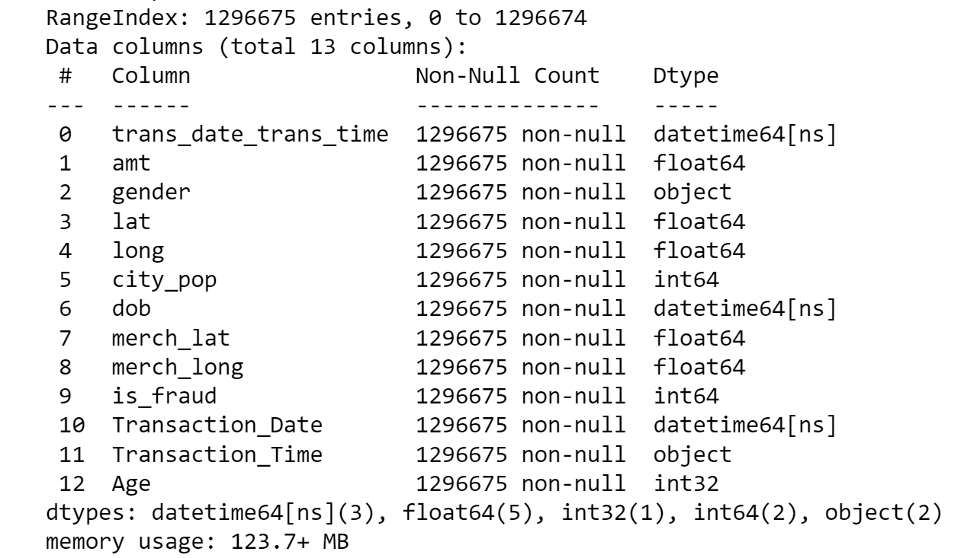
Appendix: Data Attributes

Slide 12
Appendix: Data Methodology
Built a Random Forest Classifier on the training data set obtained from Kaggle
Class Imbalanced was handling using SMOTE (Synthetic Minority Over Sampling Technique) Sampling Method
Hyperparameter for the model were manually tuned to get a good result and Grid search was also used to find the best estimators for recall value

Slide 13
THE END

